Slide 1
Concurrency
Synchronization
Prepared by: Lecturer Azizur Rahman Anik
Dept of CSE, UIU

Slide 2
Concurrency Objectives
Mutual exclusion (e.g., A and B don’t run at same time)
- solved with locks
Ordering (e.g., B runs after A does something)
- solved with condition variables and semaphores

Slide 3
Condition Variables
Condition Variable (CV): queue of waiting threads
B waits for a signal on CV before running
– wait(CV, …)
A sends signal to CV when time for B to run
– signal(CV, …)

Slide 4
Condition Variables
wait(cond_t *cv, mutex_t *lock)
- assumes the lock is held when wait() is called
- puts caller to sleep + releases the lock (atomically)
- when awoken, reacquires lock before returning
signal(cond_t *cv)
- wake a single waiting thread (if >= 1 thread is waiting)
- if there is no waiting thread, just return, doing nothing

Slide 5
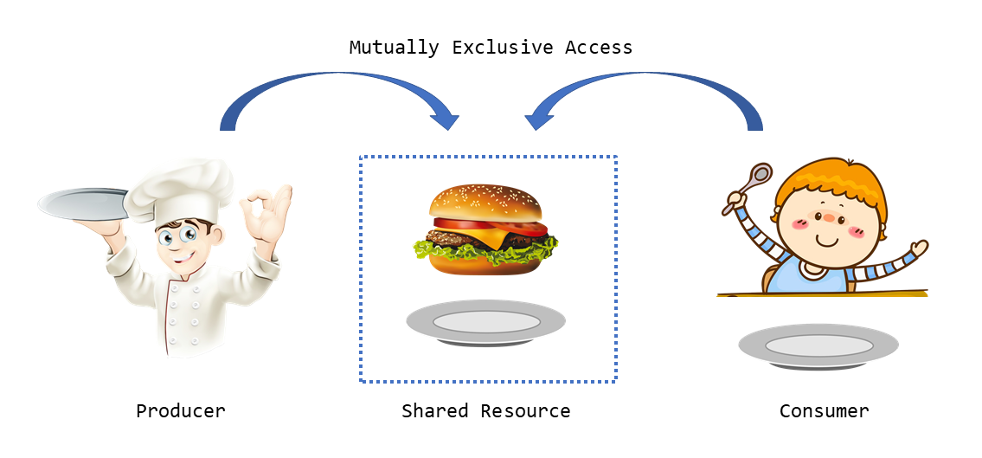
Producer/Consumer Problem

Slide 6
Producer/Consumer Problem
Producers generate data
Consumers grab data and process it
General strategy use condition variables to:
- make producers wait when buffers are full
- make consumers wait when there is nothing to consume

Slide 7
Producer/Consumer Example
Start with easy case:
– 1 producer thread
– 1 consumer thread
– 1 shared buffer to fill/consume (max = 1)
Numfull = number of buffers currently filled

Slide 8
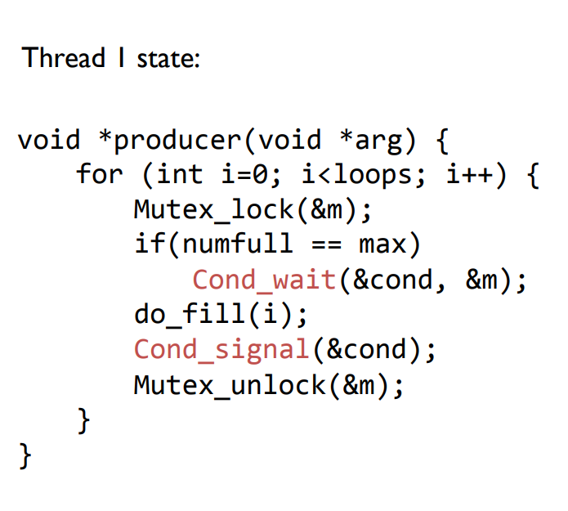
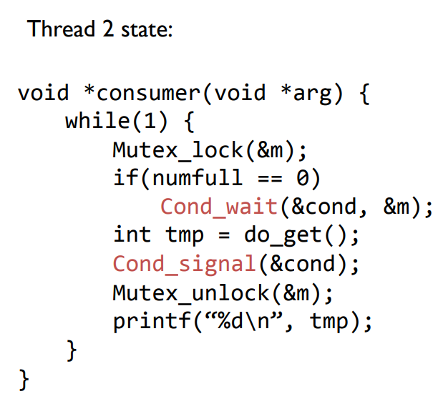
Producer/Consumer Example

Slide 9
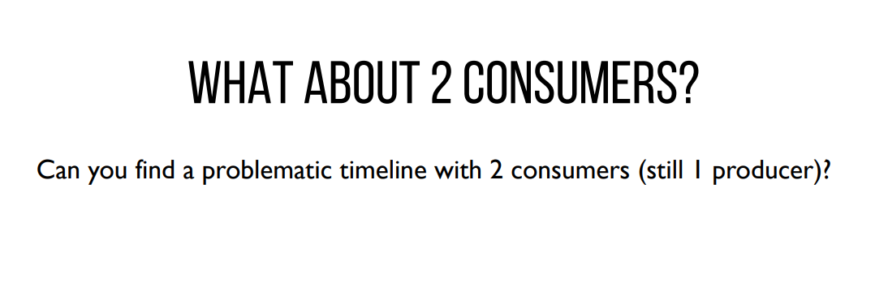

Slide 10
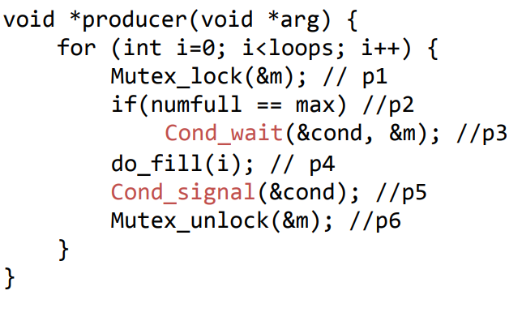
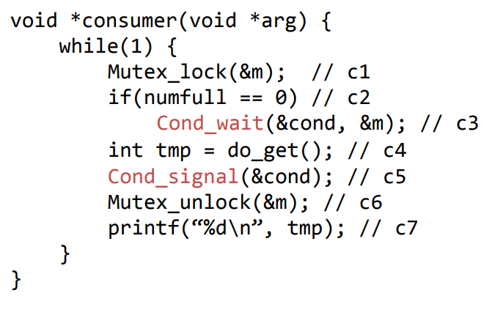
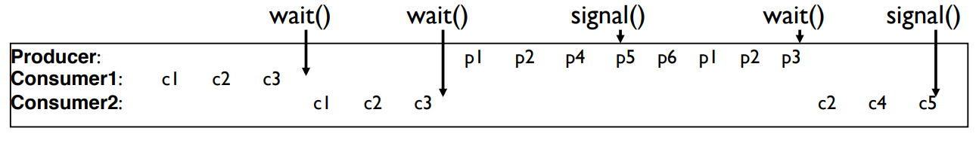
Who will get the signal?
Consumer1 or Producer?

Slide 11
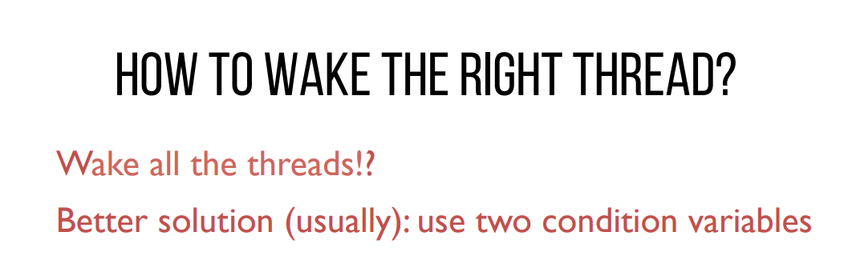

Slide 12
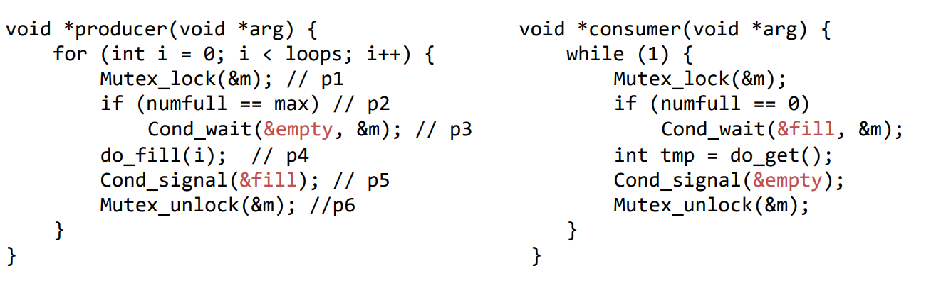
Producer/Consumer: Two CVs
Fill – used to wake up the consumer threads, as they were waiting for the buffer to be filled so that they can consume
Empty – used to wake up the producer threads, as they were waiting for the buffer to be empty so that they can produce

Slide 13
A Bug in the previous code!
1. consumer1 waits because numfull == 0
2. producer increments numfull, wakes consumer1
3. before consumer1 runs, consumer2 runs, grabs entry, sets numfull=0.
4. consumer1 then reads bad data.

Slide 14
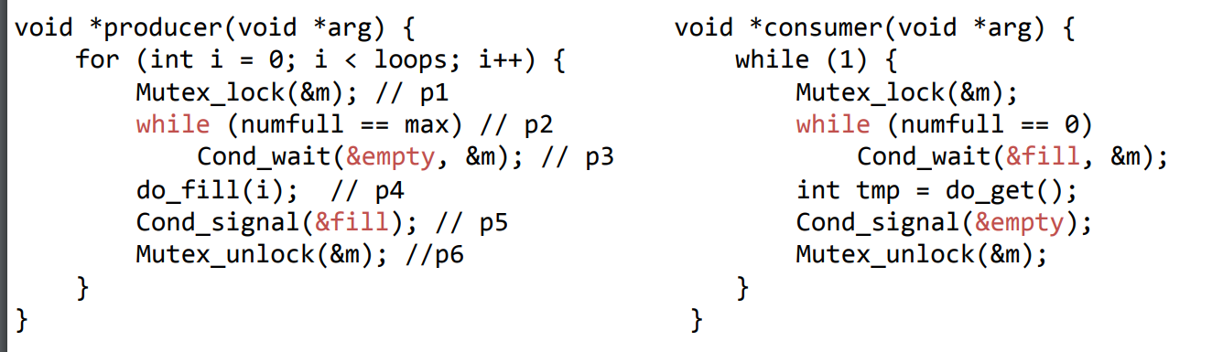
Producer/Consumer: Two CVs and WHILE
No concurrent access to shared state
Every time lock is acquired, assumptions are reevaluated
A consumer will get to run after every do_fill()
A producer will get to run after every do_get()

Slide 15
Good Rule of Thumb 3
Whenever a lock is acquired, recheck assumptions about state!
Why? Because another thread could grab lock in between signal and wakeup from wait
Note that some libraries also have “spurious wakeups” (may wake multiple waiting threads at signal or at any time)

Slide 16
Summary: rules of thumb for CVs
1. Keep state in addition to CV’s
2. Always do wait/signal with lock held
3. Whenever thread wakes from waiting, recheck state

Slide 17
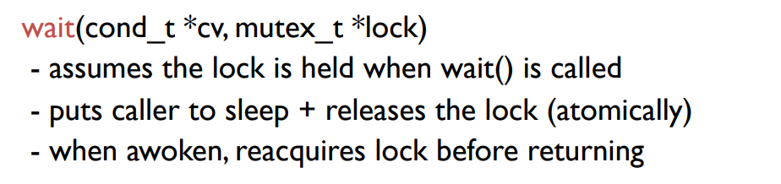
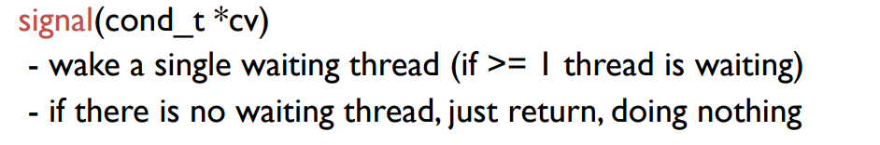
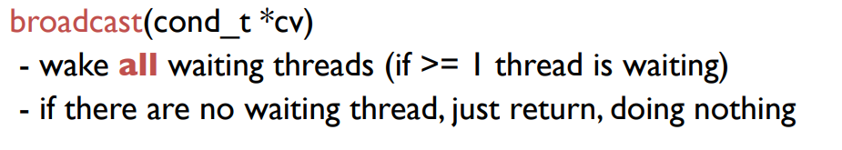
Which function does what?

